Slide 1



Medusa Implementation
By:
Sepand Haghighi
Vahid Amini
Amin Fotovat

Slide 2

Overview
Previous talk
Implementation
Results

Slide 3
Let’s Flashback!
Why graphs?
Many real-world applications:
Social Networks
Web link analysis
Challenging CUDA code?
Solution: sequential programming framework

Slide 4
GPU As An Accelerator
GPU-based solutions vs CPU-based
Improved performance
Limited to specific graph operations
Optimization for each graph processing task

Slide 5
What Medusa Offers
A Soft Framework
Simplify Programming
Novel Graph Programming Model
Edge-Message-Vertex
Suitable for parallel graph processing

Slide 6
Bulk Synchronous Parallel
A computation contains serial global steps
Each processor
Fast local memory
Communication network
Google adopt this for graph processing
Pregel
Mapreduce

Slide 7
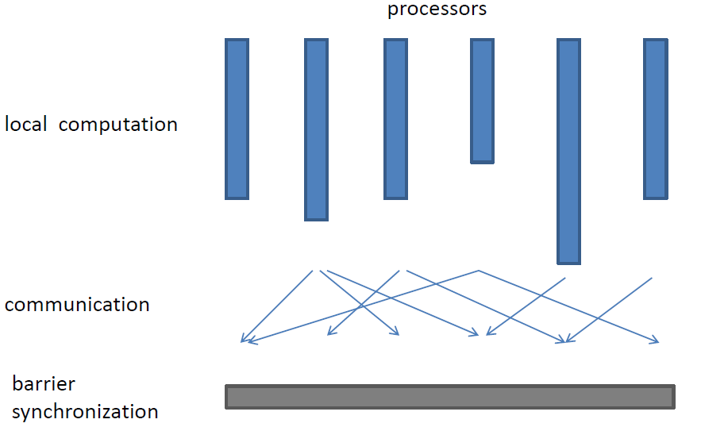
Bulk Synchronous Parallel

Slide 8
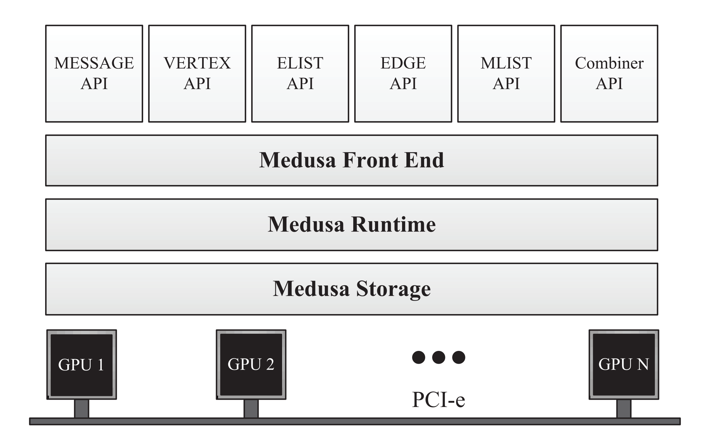
Overview of Medusa

Slide 9
Medusa Workflow
Define basic structures
Edge, Message and Vertex
Composes the main program
Initializing the graph structure
Configuring the framework parameters
Invoking the customized emv apis with the system provided apis

Slide 10
Massive Parallelism
Vertex-based api problems
Different vertices →different numbers of edges→ different workloads on each api instance.
Different number of received messages →divergence.
EMV
Individual vertices, edges or messages
Each gpu thread → one instance of the user-defined api
Collective & individual

Slide 11
Work Efficiency
Medusa’s Default
Applies the user-defined API on all vertices/edges
SetActive API
Dynamic queue
Apply the EMV APIs to the active vertices and edges only

Slide 12
Message Passing Efficiency
Fixed-size array
Information of the buffer size
Output position
Need grouping operation
Dynamic list
No pre-computation
No grouping operation
Need atomic operation

Slide 13
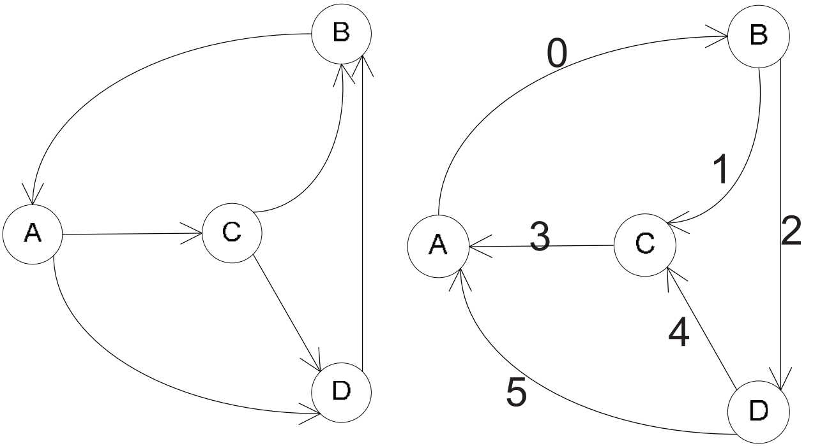
Reversed Edge Indexed

Slide 14
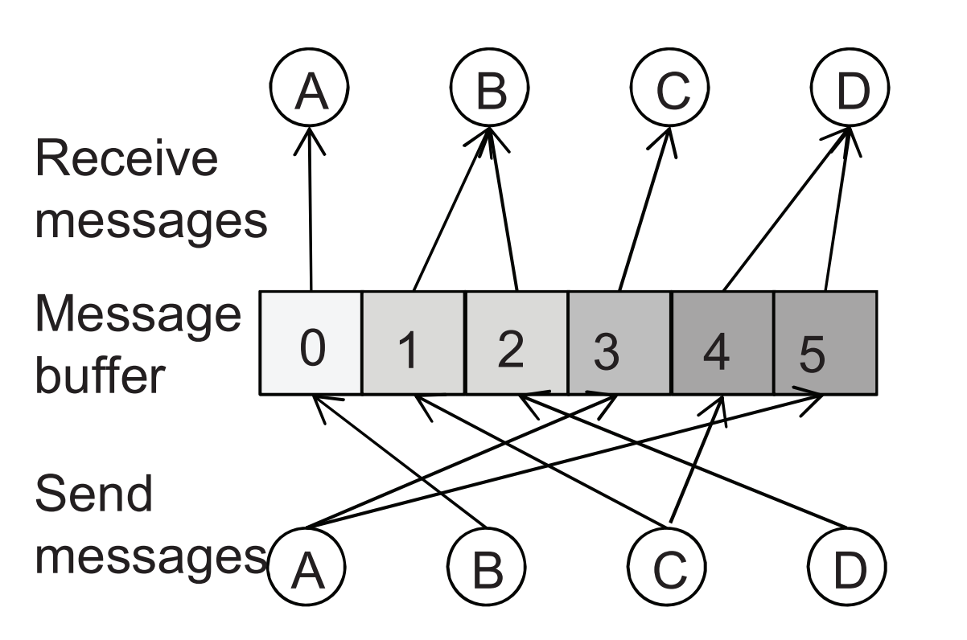
Reversed Edge Indexed

Slide 15
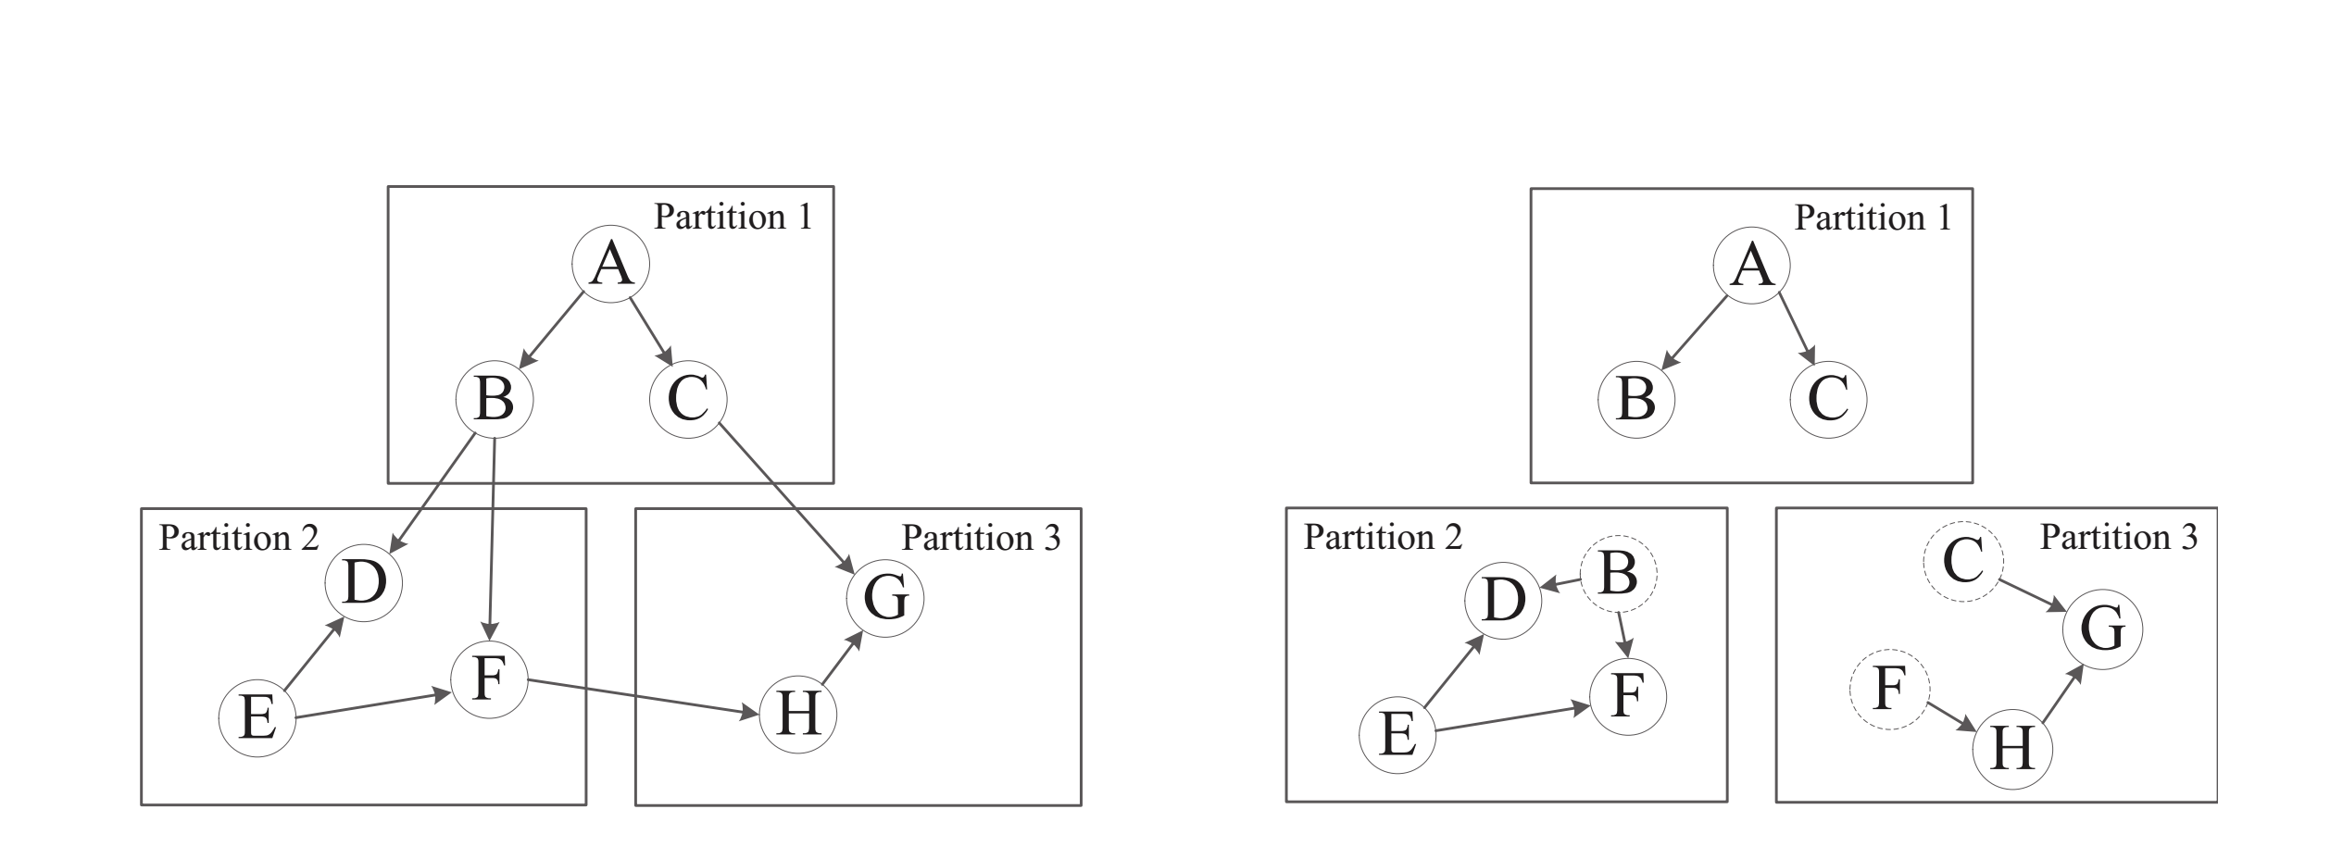
Multi-GPU Execution (Replication)

Slide 16
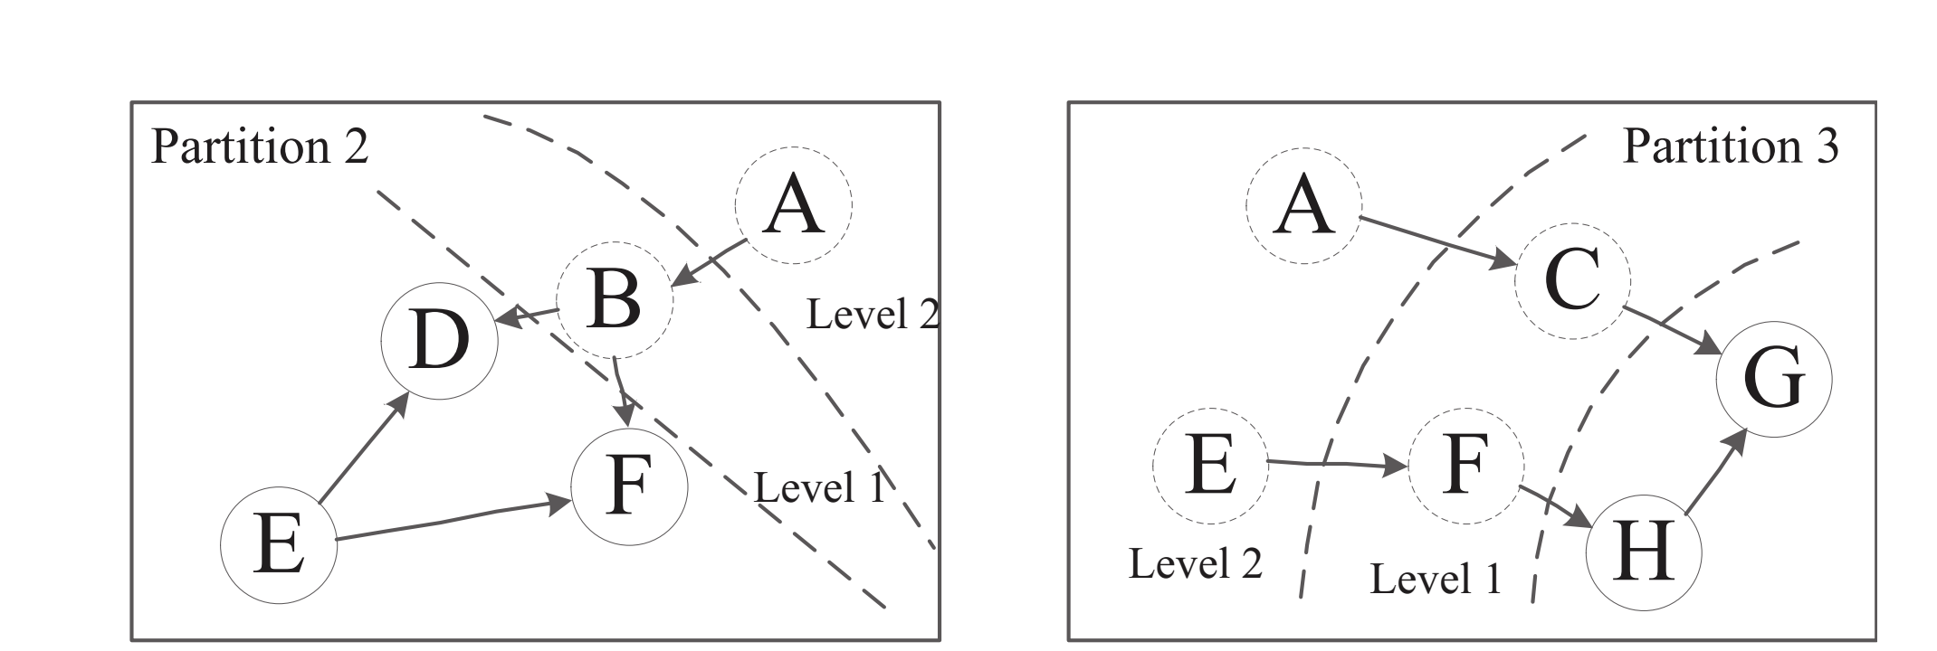
Multi-GPU Execution (Multi-hop)

Slide 17
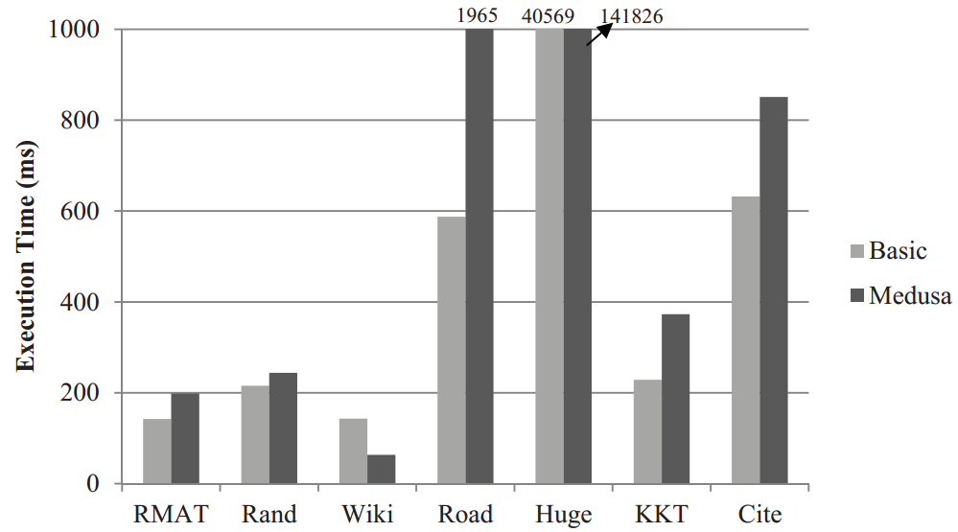
Performance

Slide 18
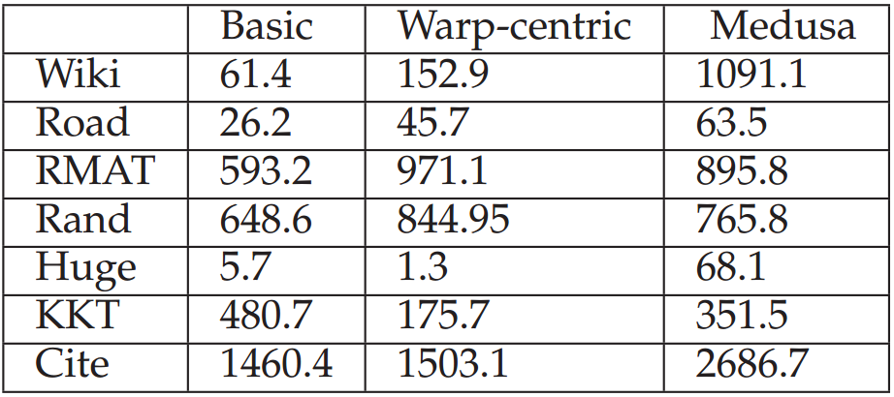
TEPS Comparison

Slide 19
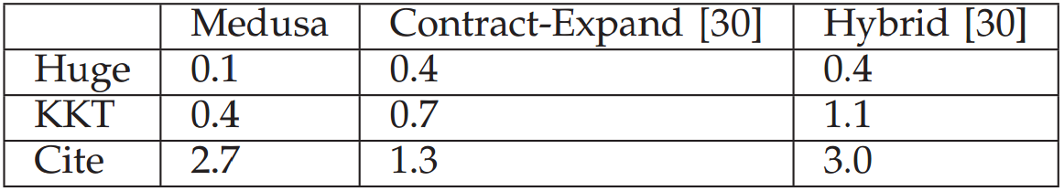
TEPS Comparison (Cont’d)

Slide 20
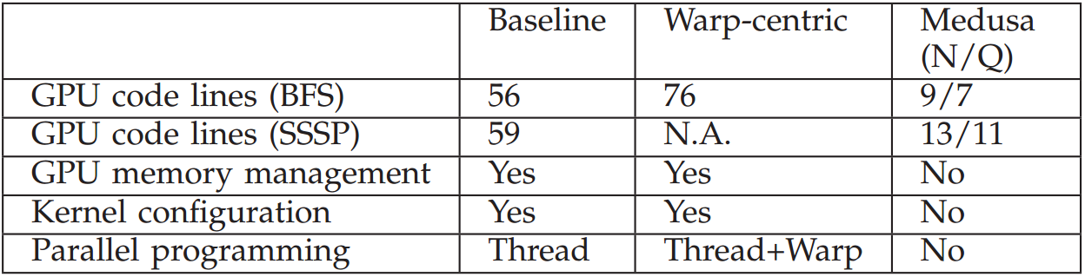
Programmability
Code Complexity
Number of lines!

Slide 21
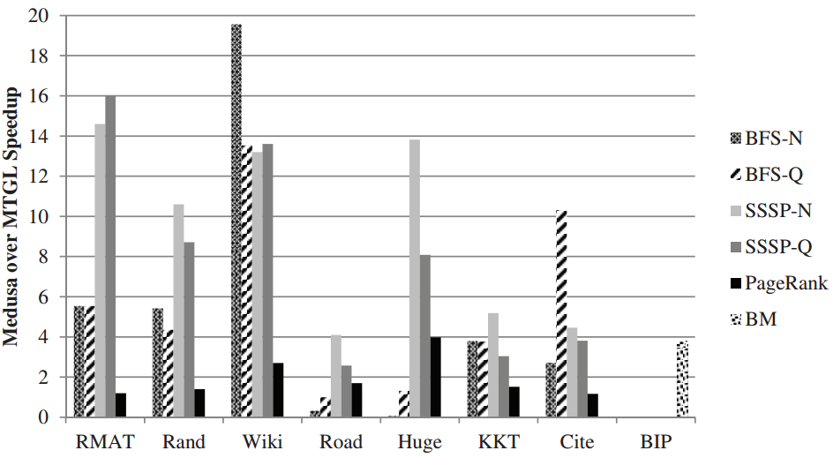
Efficiency
Compare with MTGL
Speedup
MTGL / Medusa

Slide 22
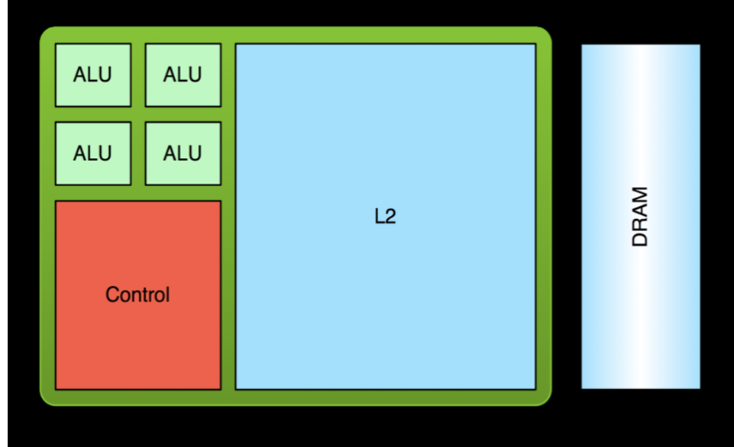
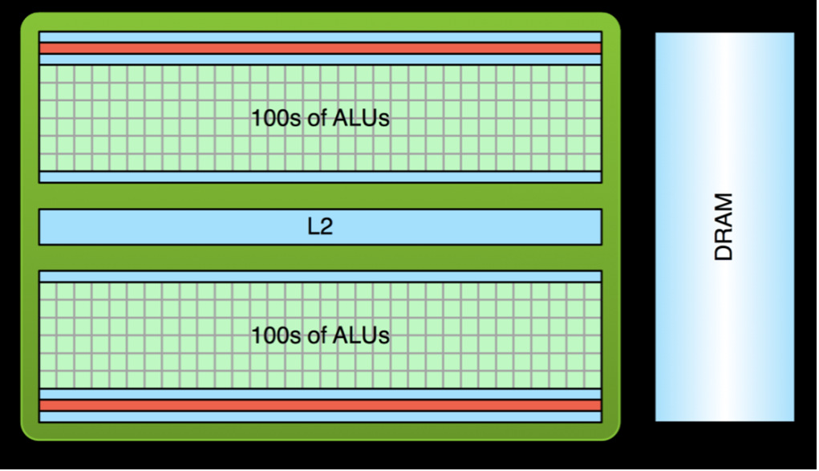
GPU vs CPU

Slide 23
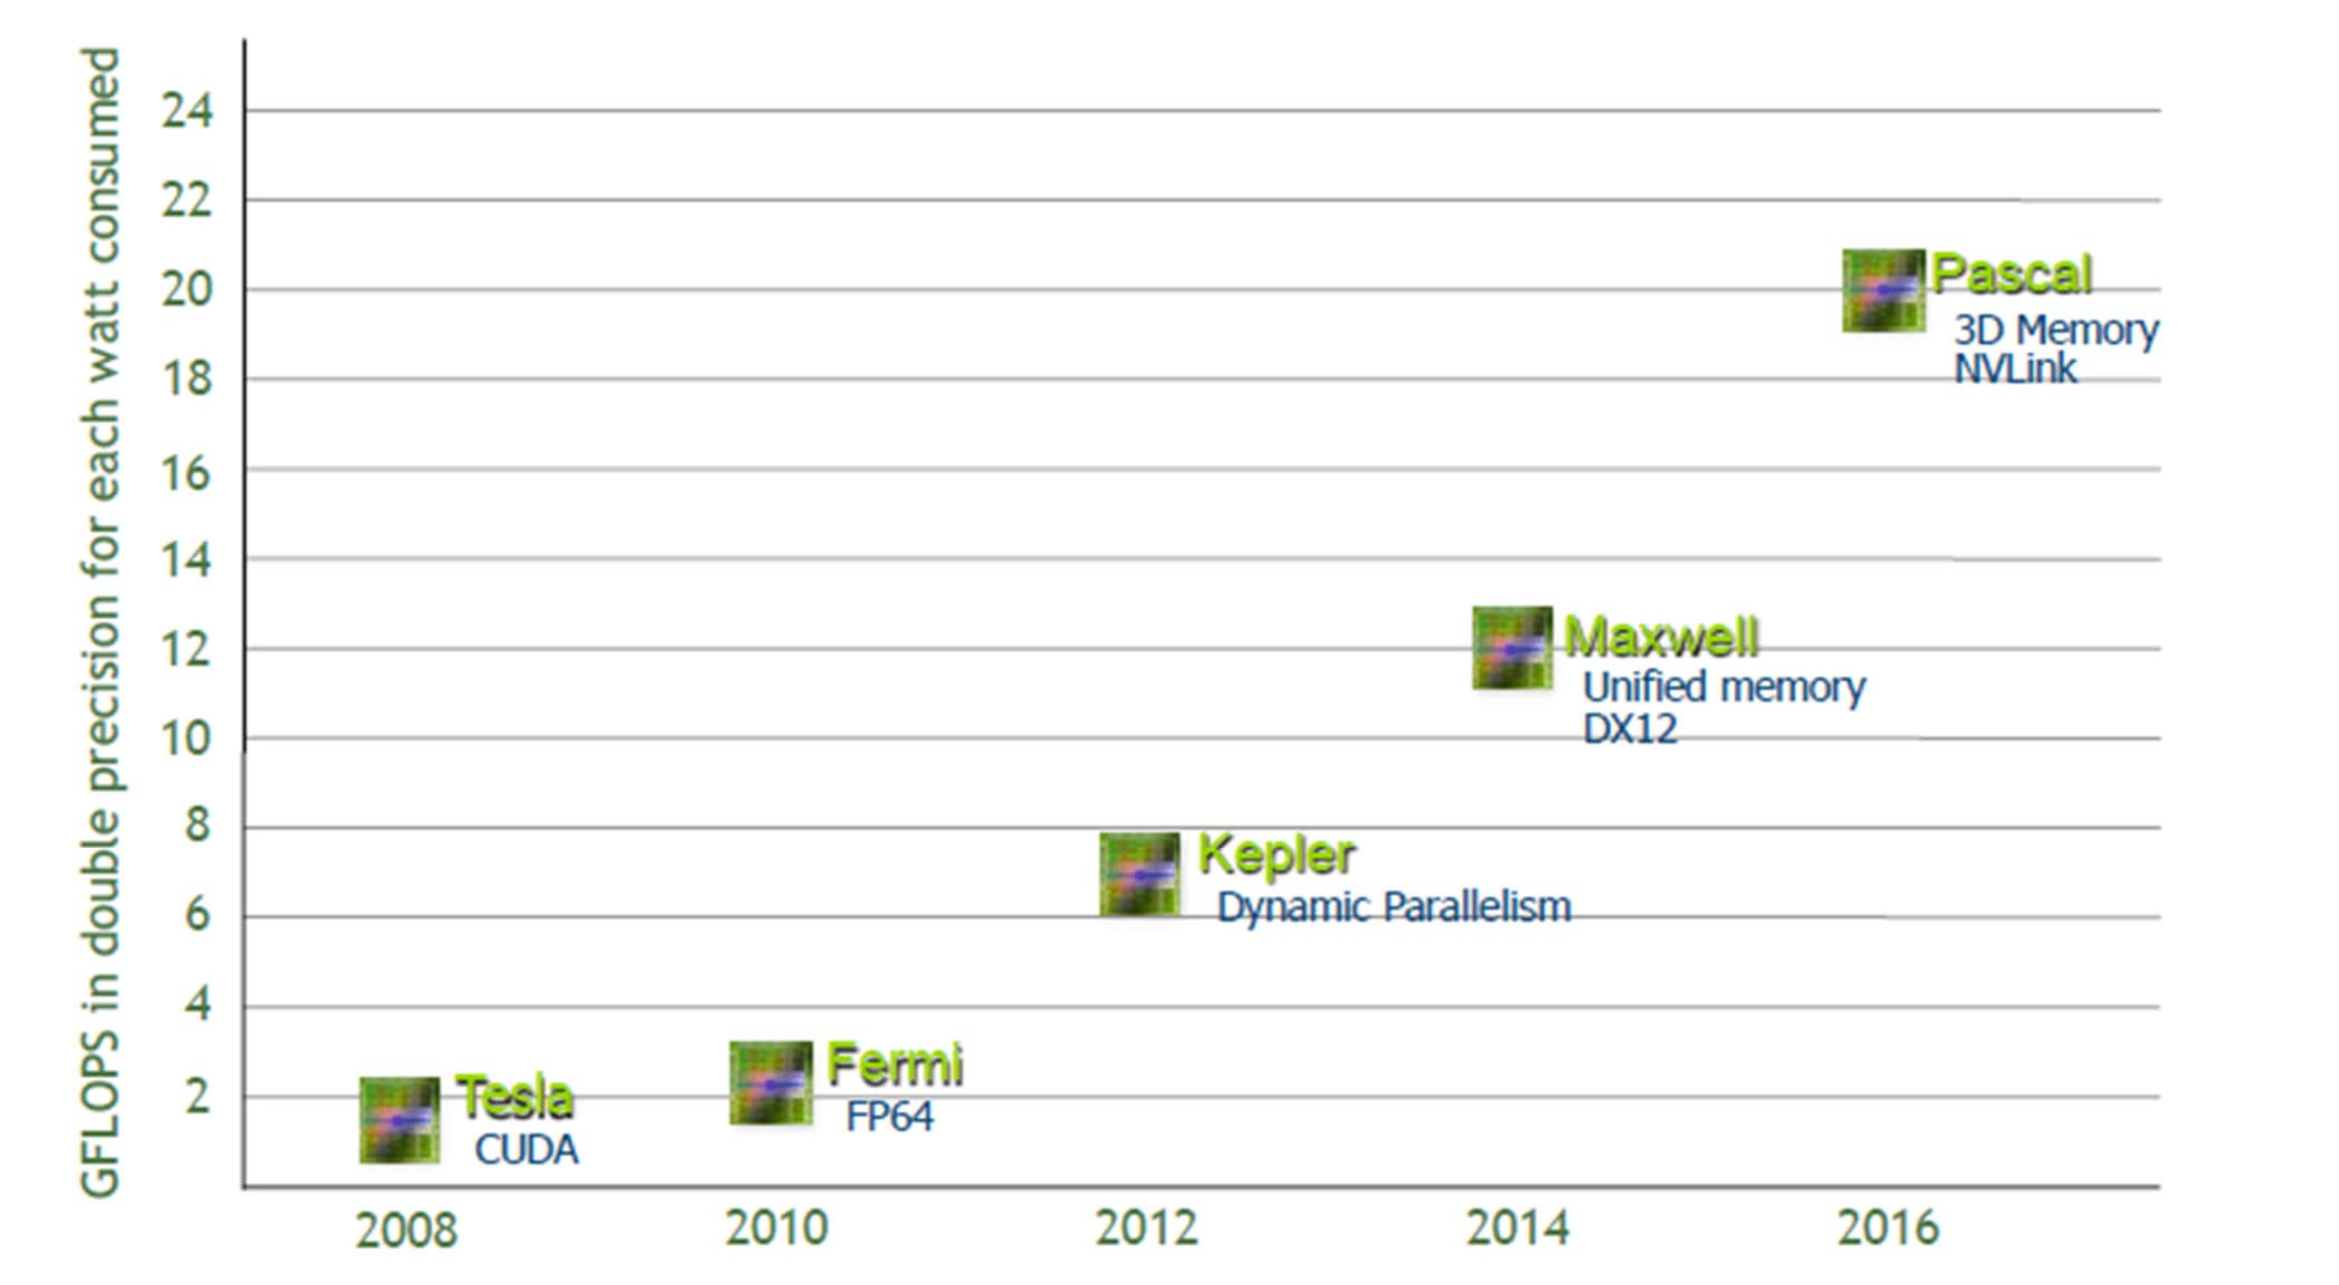
Hardware Generation

Slide 24
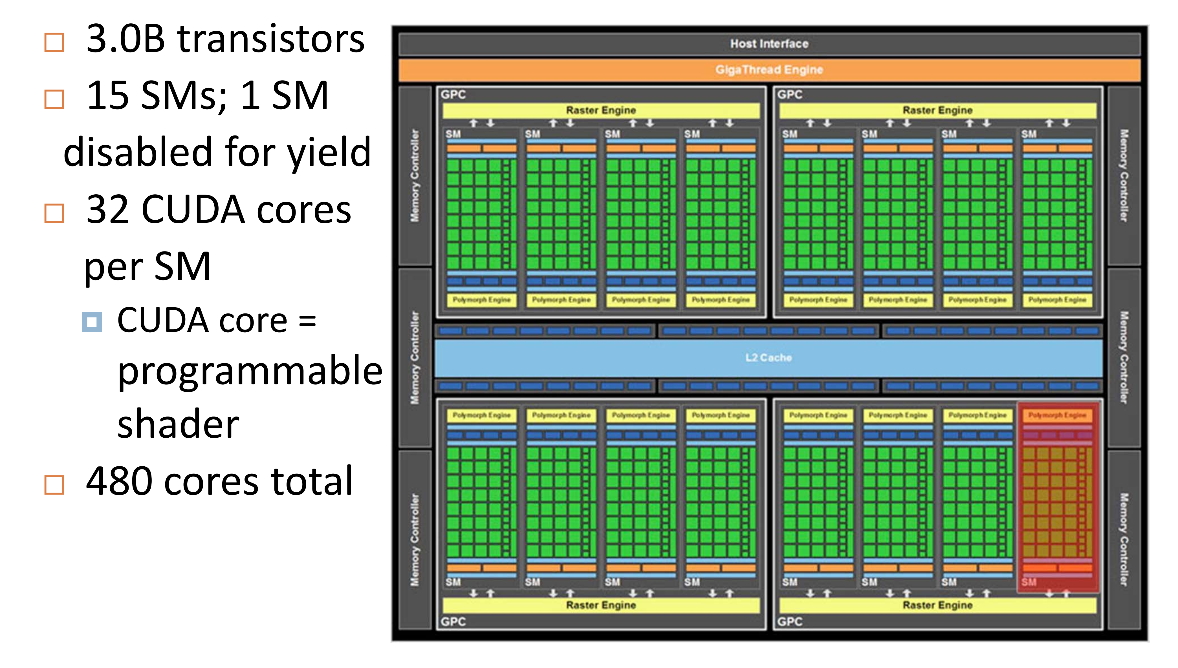
Nvidia Fermi GPU (2010)

Slide 25
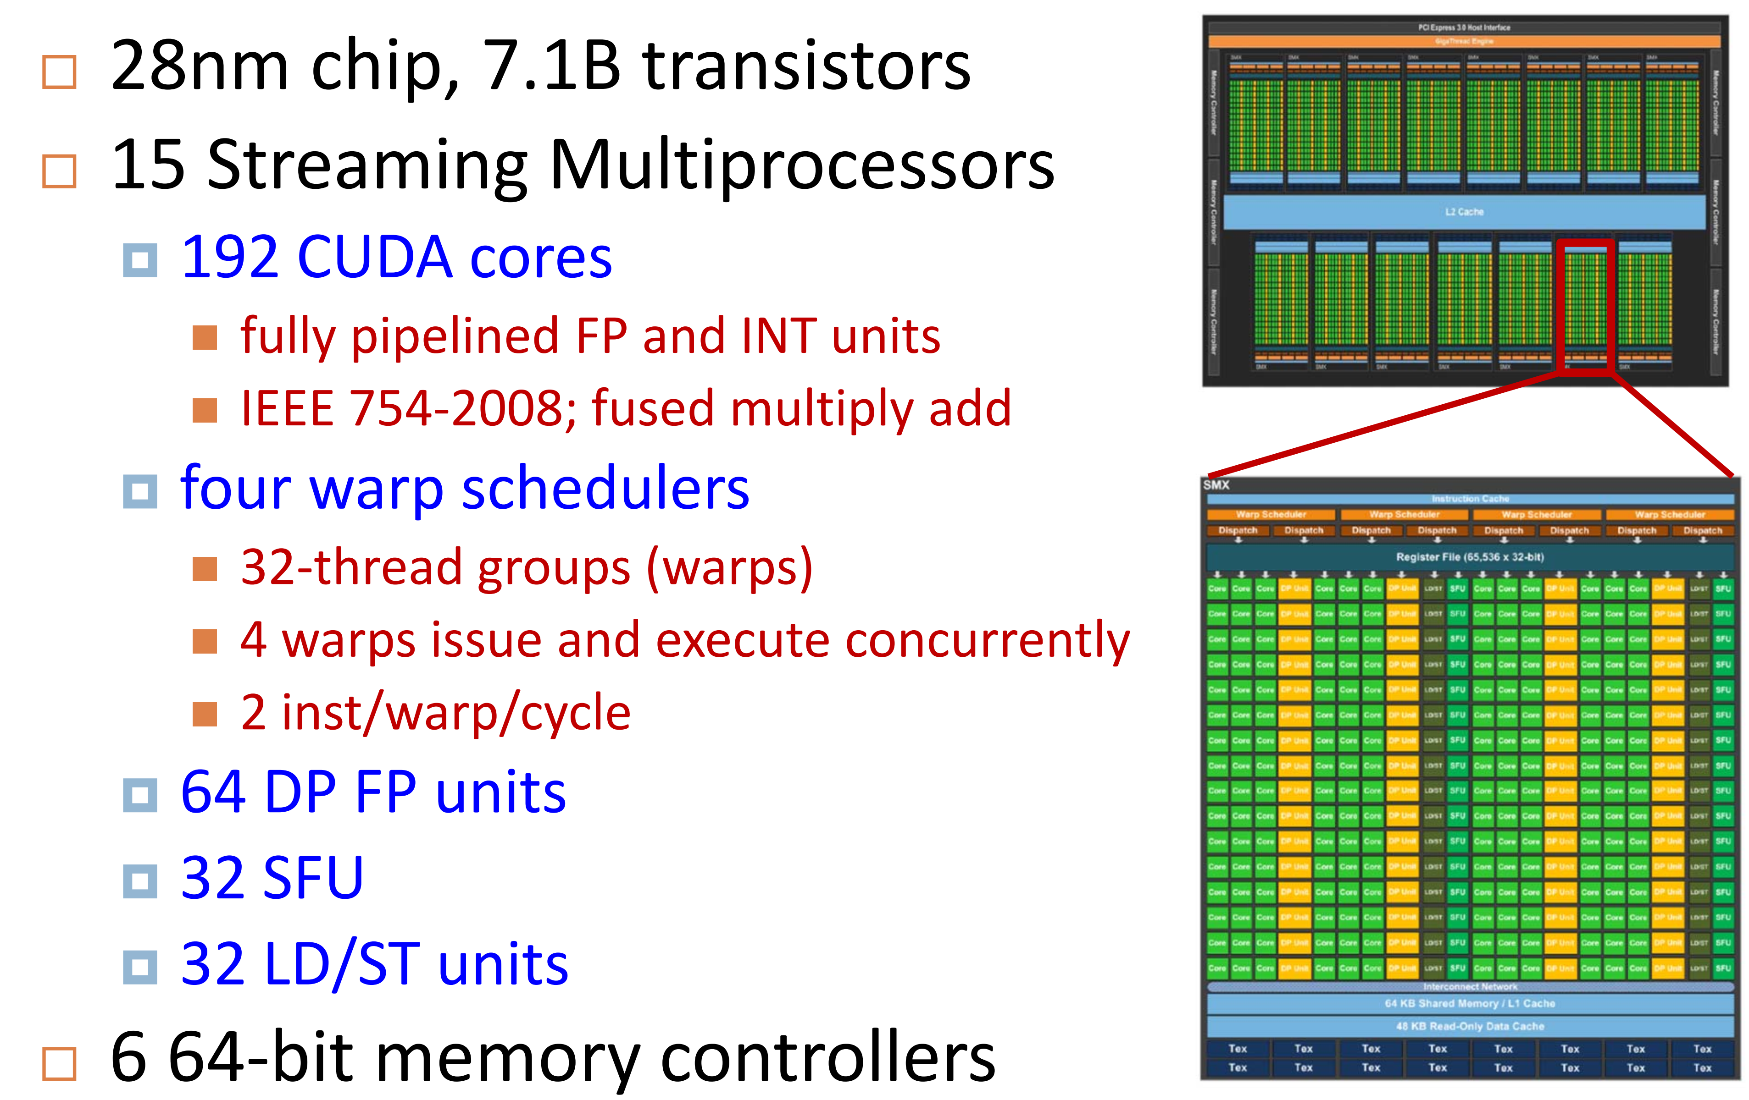
Nvidia Kepler (2012)

Slide 26
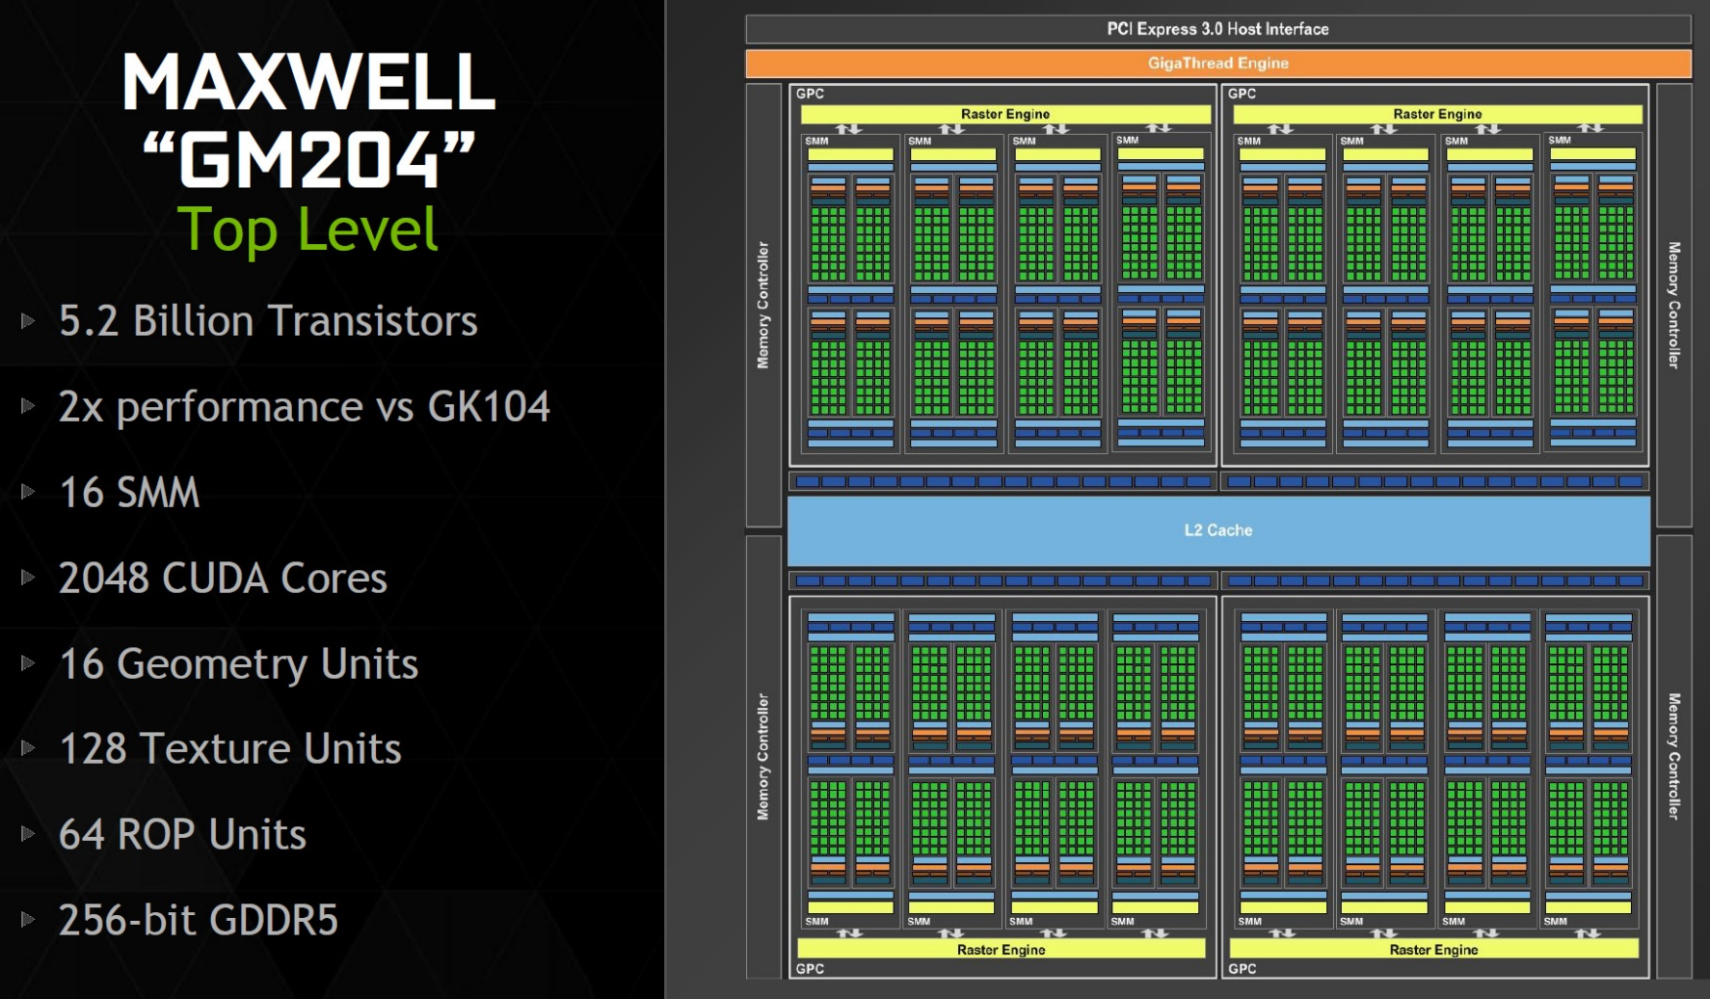
Nvidia MAXWELL (2015)

Slide 27
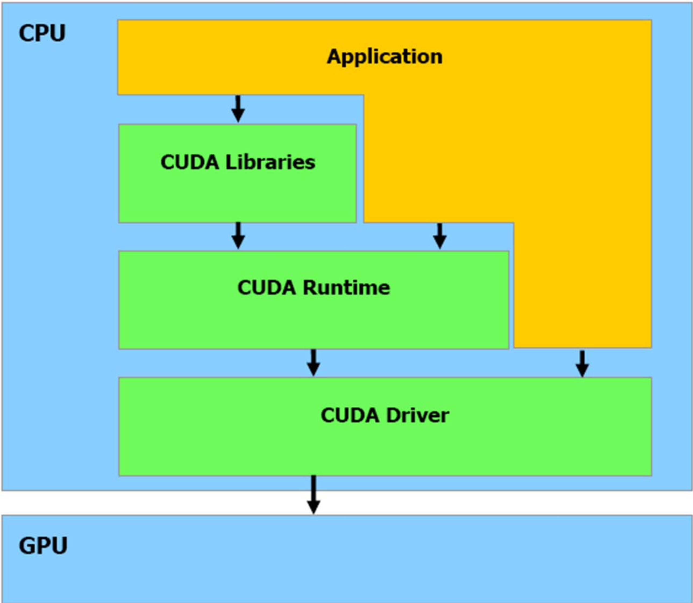
CUDA Software Stack

Slide 28
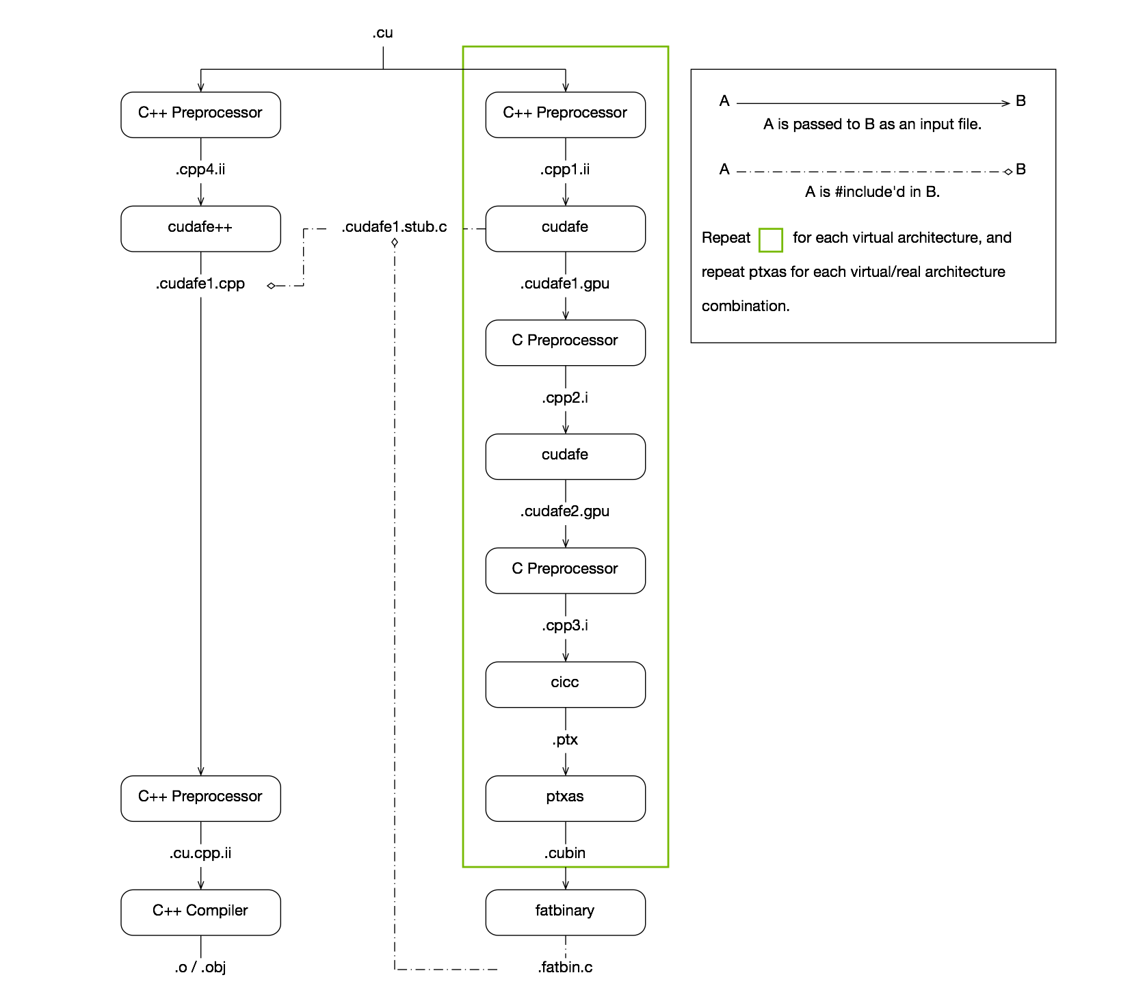
CUDA Compilation

Slide 29
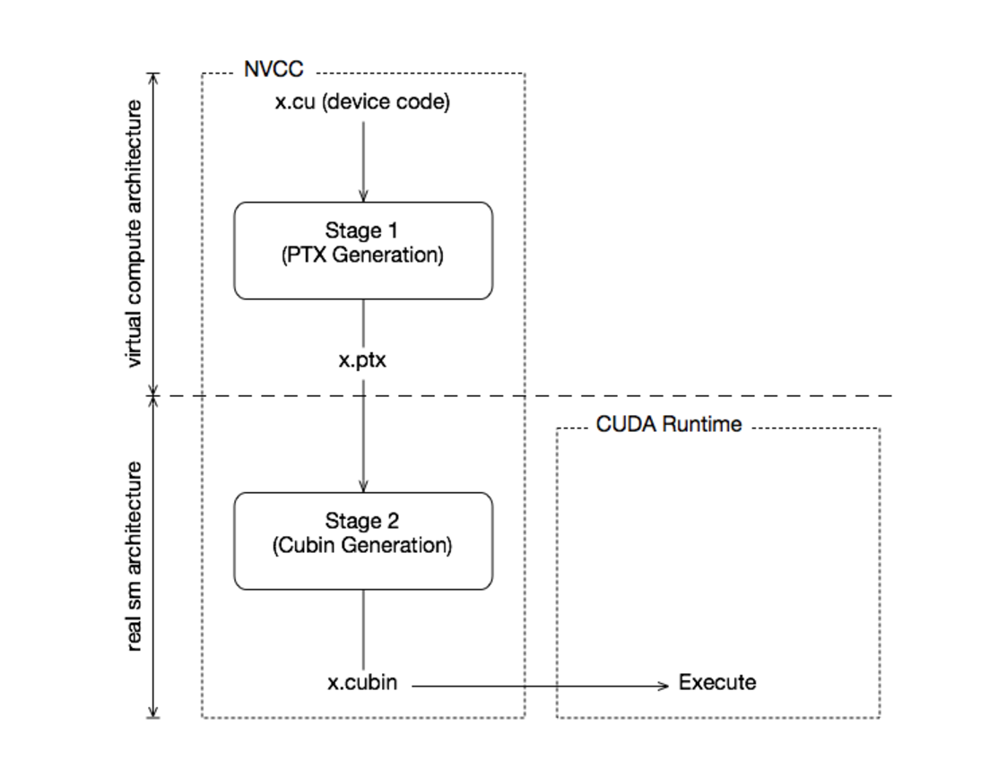
CUDA Compilation (cont’d)

Slide 30
CUDA BFS Sample
void BFSGraph( int argc, char** argv)
{
char *input_f;
if(argc!=2){
Usage(argc, argv);
exit(0);
}
input_f = argv[1];
printf("Reading File\n");
//Read in Graph from a file
fp = fopen(input_f,"r");
if(!fp)
{
printf("Error Reading graph file\n");
return;
}
int source = 0;

Slide 31
CUDA BFS Sample
Node* d_graph_nodes;
cudaMalloc( (void**) &d_graph_nodes, sizeof(Node)*no_of_nodes) ;
cudaMemcpy( d_graph_nodes, h_graph_nodes, sizeof(Node)*no_of_nodes, cudaMemcpyHostToDevice);
int* d_graph_edges;
cudaMalloc( (void**) &d_graph_edges, sizeof(int)*edge_list_size) ;
cudaMemcpy( d_graph_edges, h_graph_edges, sizeof(int)*edge_list_size, cudaMemcpyHostToDevice);
//Copy the Mask to device memory
bool* d_graph_mask;
cudaMalloc( (void**) &d_graph_mask, sizeof(bool)*no_of_nodes) ;
cudaMemcpy( d_graph_mask, h_graph_mask, sizeof(bool)*no_of_nodes, cudaMemcpyHostToDevice);

Slide 32
CUDA Kernel
#ifndef _KERNEL_H_
#define _KERNEL_H_
__global__ void
Kernel( Node* g_graph_nodes, int* g_graph_edges,
…
{
int tid = blockIdx.x*MAX_THREADS_PER_BLOCK + threadIdx.x;
if( tid<no_of_nodes && g_graph_mask[tid])
{
g_graph_mask[tid]=false;
for(int i=g_graph_nodes[tid].starting; i<(g_graph_nodes[tid].no_of_edges + g_graph_nodes[tid].starting); i++)
{
int id = g_graph_edges[i];
…

Slide 33
CUDA Kernel
#ifndef _KERNEL_H_
#define _KERNEL_H_
__global__ void
Kernel( Node* g_graph_nodes, int* g_graph_edges,
…
{
int tid = blockIdx.x*MAX_THREADS_PER_BLOCK + threadIdx.x;
if( tid<no_of_nodes && g_graph_mask[tid])
{
g_graph_mask[tid]=false;
for(int i=g_graph_nodes[tid].starting; i<(g_graph_nodes[tid].no_of_edges + g_graph_nodes[tid].starting); i++)
{
int id = g_graph_edges[i];
…

Slide 34
IMPLEMENTATION

Slide 35
Medusa Requirements
Programming
CUDA 4.2
C++ 03
Build
gcc
CUDA nvcc

Slide 36
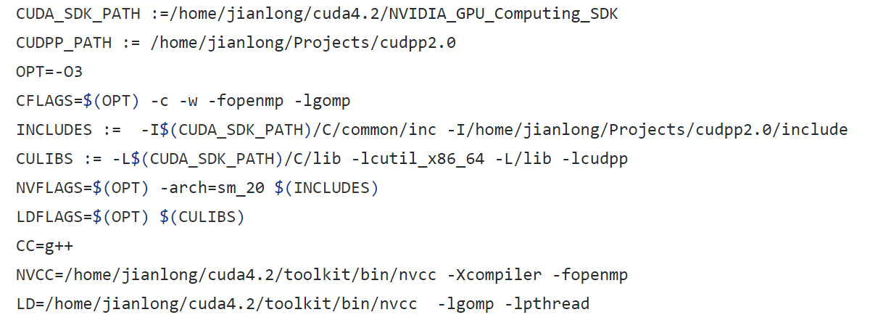
How to build Medusa

Slide 37
Difficulties
Bad Documentation
About 4000 lines of code without comments
No details about compiler version
Cuda backward compatibility problem
Old Nvidia Architecture Kernels
Graph Generator Problem

Slide 38
Maxwell Compatibility Problem
Need PTX if application built using CUDA v. 2.1~ 5.5
Different major version number aren’t compatible with each other
http://docs.nvidia.com/cuda/maxwell-compatibility-guide/#axzz4iGD7BuLS

Slide 39
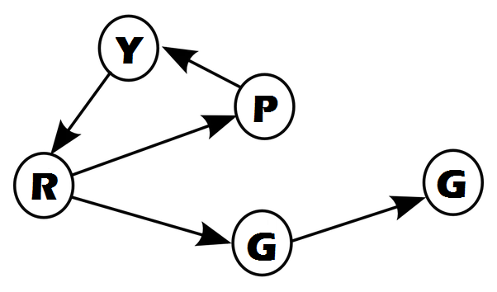
Python Random Graph Generator
Based on DIMACS
Written in Python
Available on our repo (Github)
http://github.com/sepandhaghighi/pyrgg

Slide 40

DIMACS Standard
A graph contains n nodes and m arcs
Nodes are identified by integers 1...n
Graphs can be interpreted as directed or undirected
Graphs can have parallel arcs and self-loops
Arc weights are signed integers

Slide 41
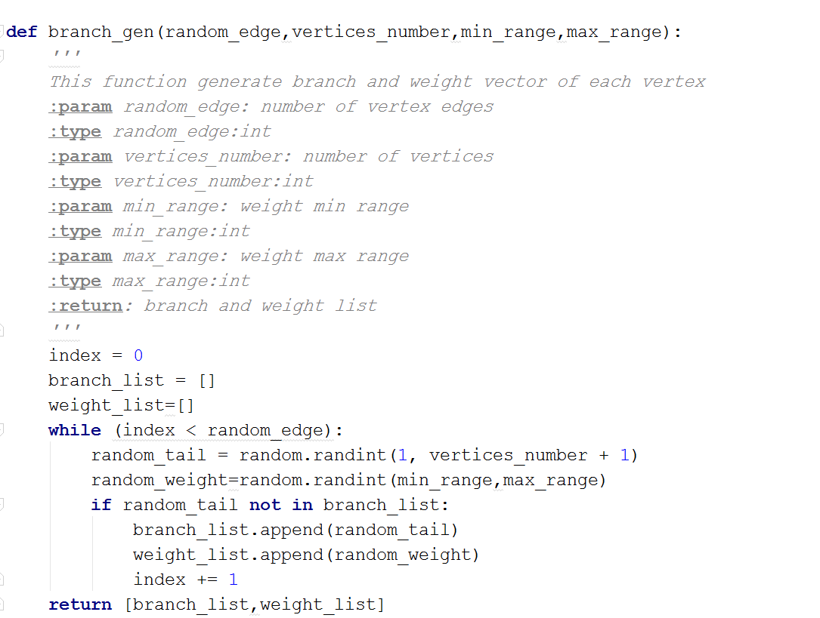
Pyrgg (branch_gen)

Slide 42
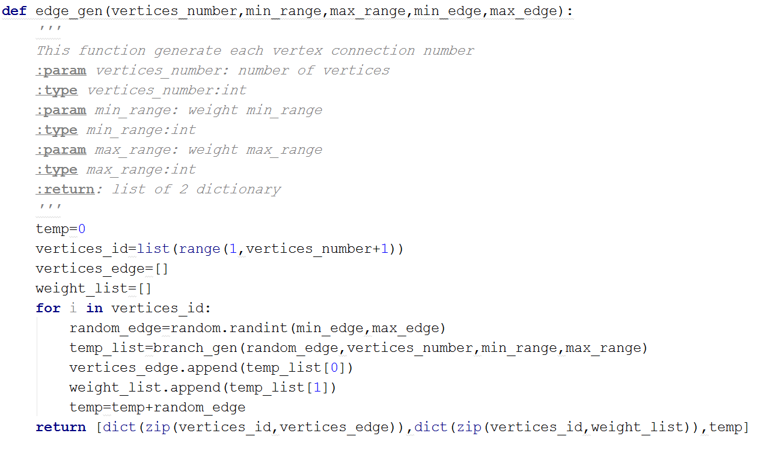
Pyrgg (edge_gen)

Slide 43
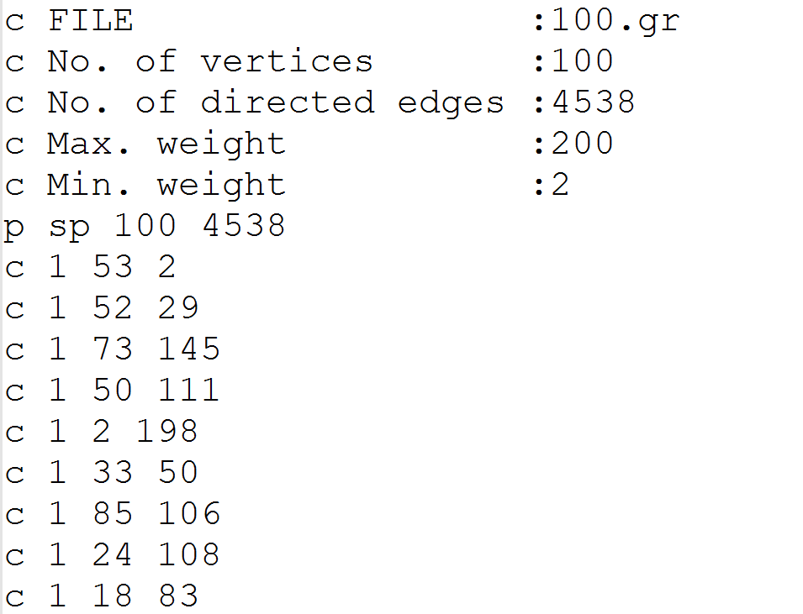
Output

Slide 44


